Slide 1

UNLOCKING INSIGHTS INTO THE GLOBAL AIR TRANSPORTATION NETWORK

Slide 2

INTRODUCTION
Project Description:
Technical Architecture:
This Global Air Transportation Network dataset is a comprehensive collection of information on airports, airlines and their routes. It contains information such as names, cities, countries, codes (IATA and ICAO) longitudes, latitudes and altitudes of airports across the world with detailed time zone and daylight saving time data. Additionally, this includes information about airlines including their IDs, name aliases, IATA and ICAO codes, callsigns country of origin and active/inactive status. Similarly, it also covers route details such as airline sources to destination airports along with essential details like codeshare stakeholder if any stops required during this journey along with the type of aircraft being used for that particular journey. This dataset has been compiled through meticulous labor by researchers all over the world to give you a comprehensive detail into air transportation networks from around the globe.

Slide 3
EMPATHY MAP AND BRAINSTORM IDEA PRIORITIZATION

Slide 6
VISUALIZATION

Slide 7
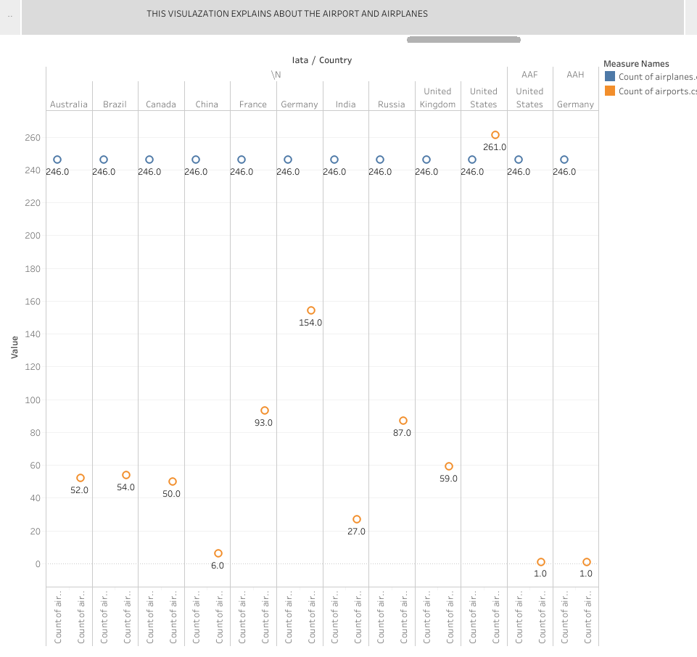
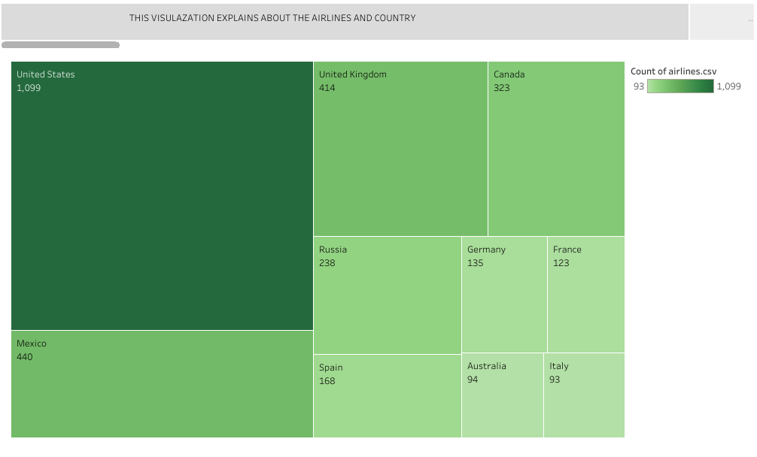

Slide 8
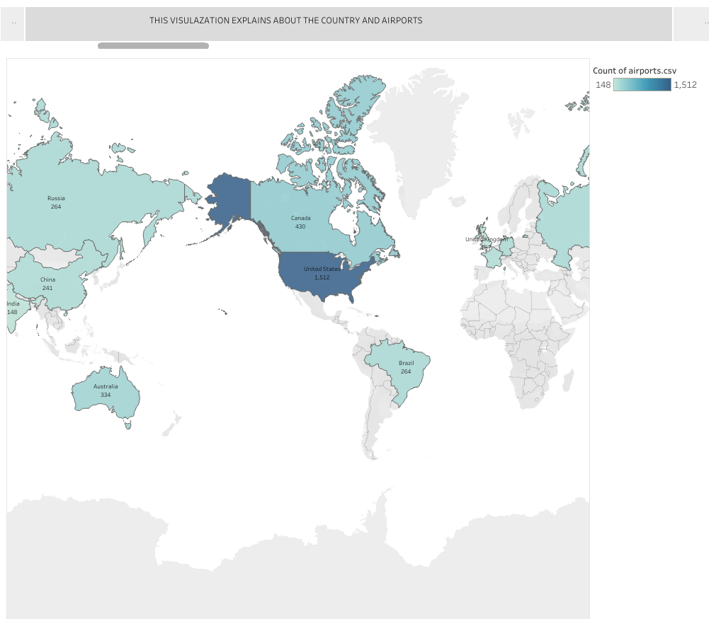
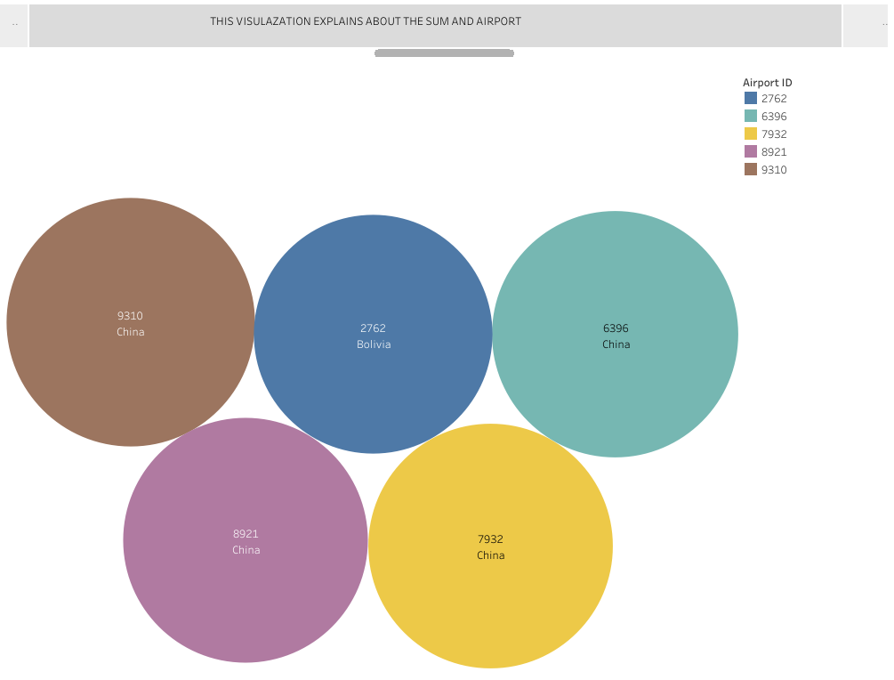
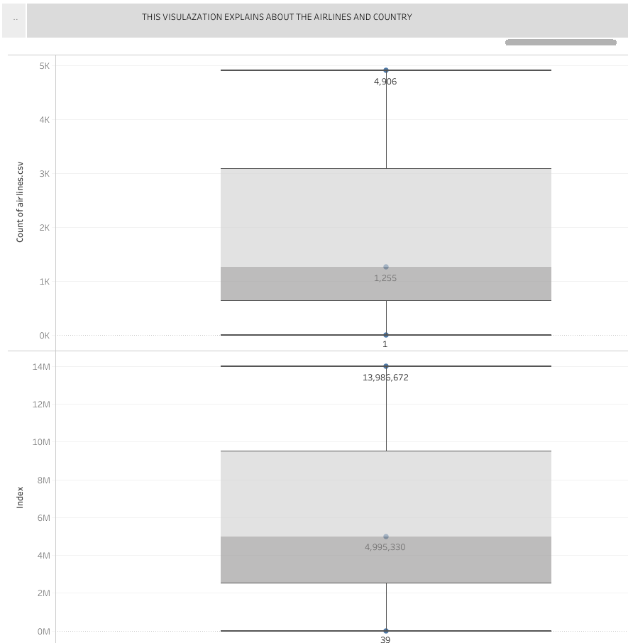

Slide 9
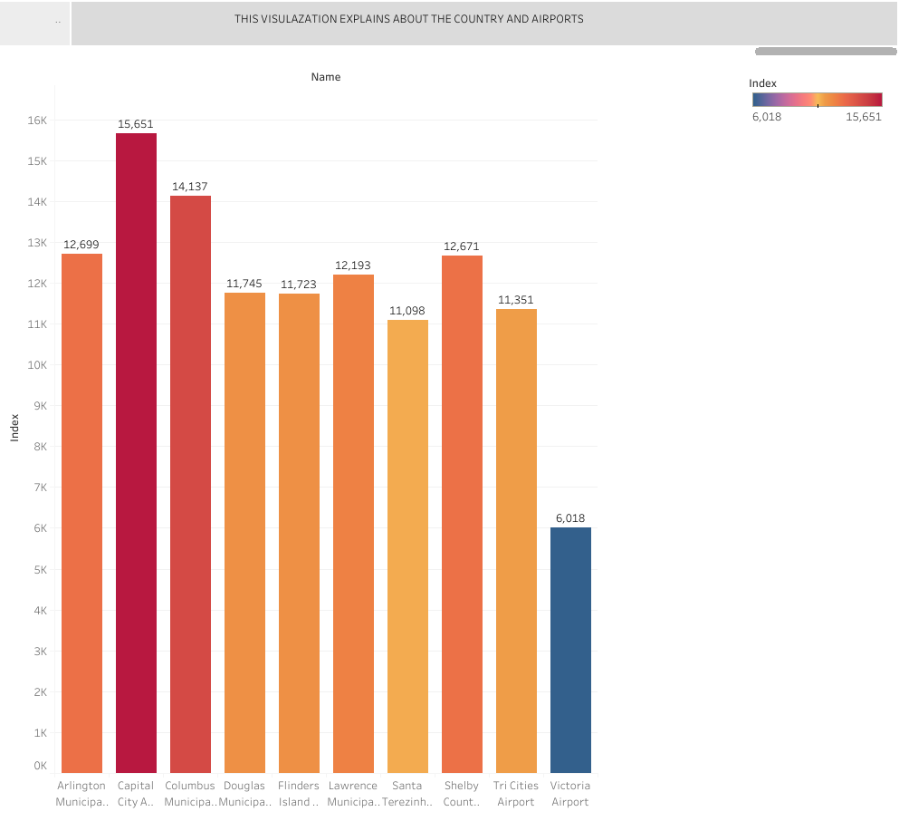
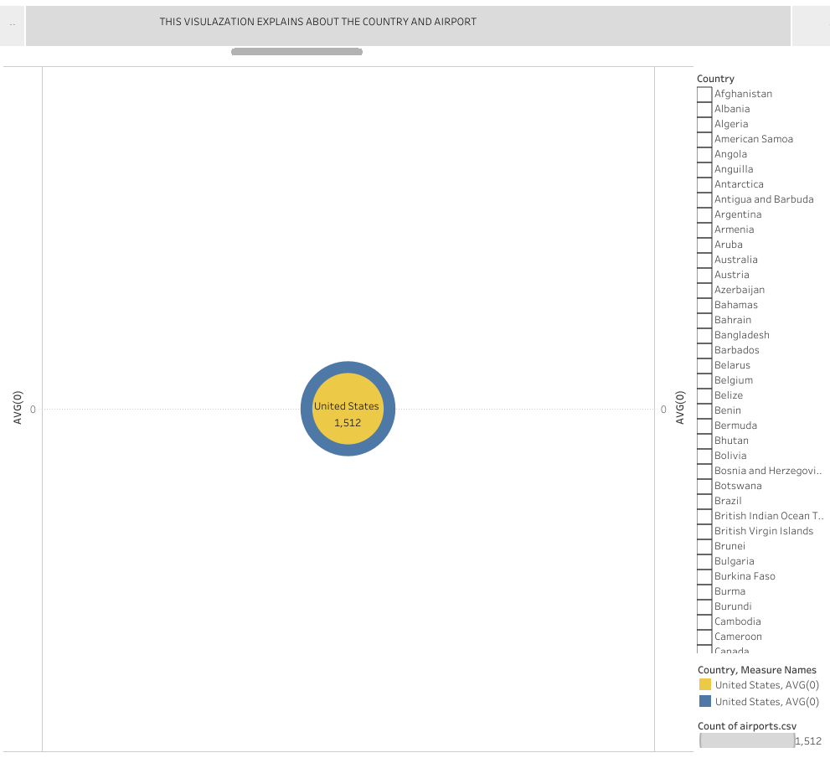

Slide 10
STORY

Slide 15
DASHBOARD

Slide 16
UNLOCKING INSIGHTS INTO THE GLOBAL AIR TRANSPORTATION NETWORK

Slide 17
THANK YOU

